Slide 1
Introduction to Spain
Exploring the Beauty and Culture of Spain

Slide 2
Location and Geography
Spain is located in southwestern Europe on the Iberian Peninsula.
It borders France to the north, Portugal to the west, and the Mediterranean Sea to the east and south.
The country consists of diverse landscapes, including beautiful beaches, mountains, and vibrant cities.

Slide 3
History and Culture
Spain has a rich history dating back thousands of years.
It was influenced by various civilizations, including the Romans, Moors, and Celts.
Spanish culture is known for its flamenco music and dance, bullfighting, delicious cuisine, and vibrant festivals.

Slide 4
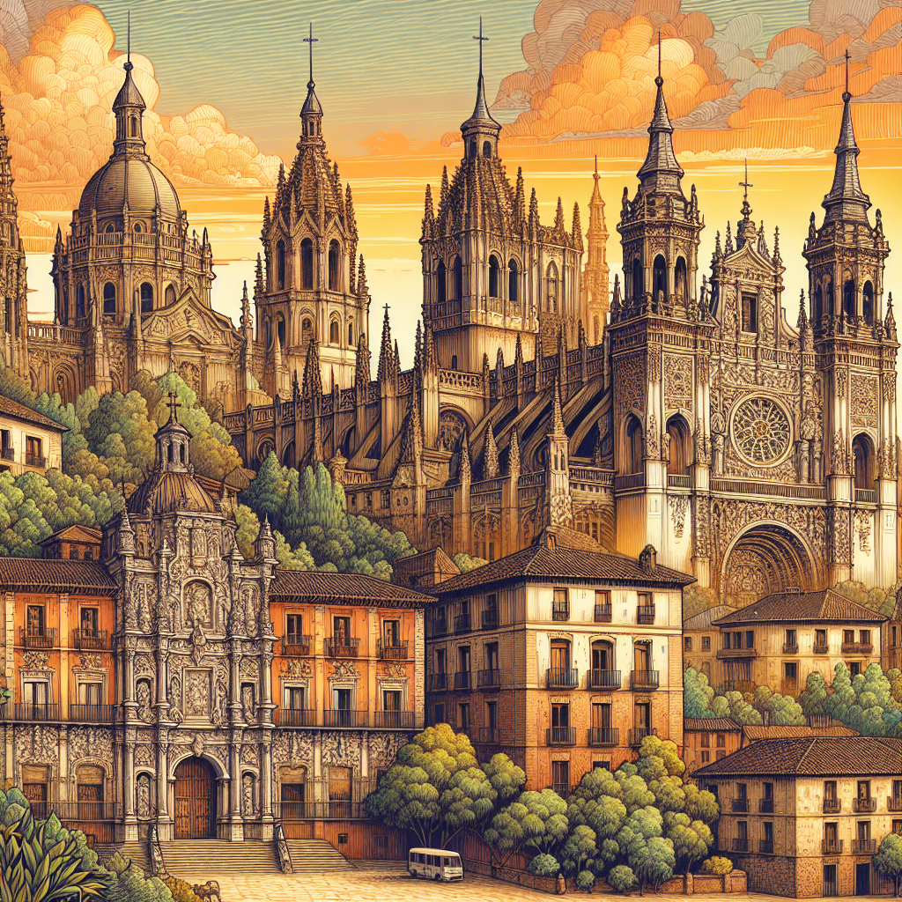
Famous Landmarks
Spain is home to many iconic landmarks that attract tourists from around the world.
Some of the most famous landmarks include the Sagrada Familia in Barcelona, the Alhambra in Granada, and the Prado Museum in Madrid.
These landmarks showcase the stunning architecture and artistic heritage of Spain.
Sagrada Familia

Slide 5
Cuisine and Wine
Spanish cuisine is renowned for its delicious flavors and variety.
Some popular dishes include paella, tapas, and gazpacho.
Spain is also known for its wine production, with regions such as Rioja and Catalonia producing high-quality wines.

Slide 6
Tourism and Attractions
Tourism plays a significant role in Spain's economy.
The country offers a wide range of attractions, from beautiful beaches in Costa del Sol and Balearic Islands to historic cities like Barcelona and Madrid.
Other popular destinations include the Canary Islands, Seville, and Valencia.

Slide 7
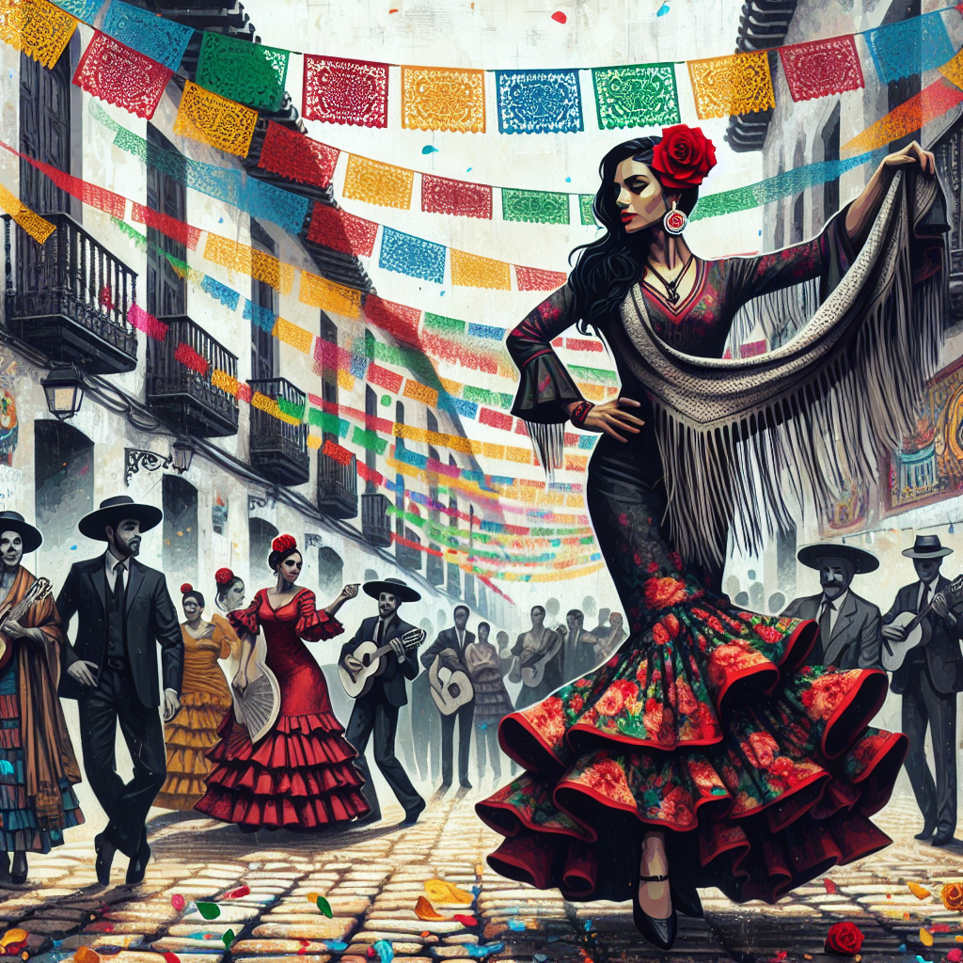
Spanish Festivals
Spain is famous for its vibrant festivals and celebrations.
Some popular festivals include La Tomatina, a tomato-throwing festival in Buñol, and San Fermín, known for the Running of the Bulls in Pamplona.
These festivals showcase the lively and joyful spirit of the Spanish people.
La Tomatina

Slide 8
Sports and Leisure
Sports play a significant role in the Spanish culture.
Football (soccer) is the most popular sport, with clubs like Real Madrid and Barcelona FC having a large fan base.
Other popular sports include basketball, tennis, and bullfighting.

Slide 9
Spanish Language
The official language of Spain is Spanish, also known as Castilian.
Spanish is one of the most widely spoken languages in the world, with over 480 million native speakers.
Learning Spanish offers many opportunities for cultural immersion and communication with Spanish-speaking countries.

Slide 10
Conclusion
In conclusion, Spain offers a unique blend of history, culture, cuisine, and natural beauty.
Whether you're exploring the iconic landmarks, indulging in delicious tapas, or enjoying the lively festivals, Spain has something to offer for every traveler.
Plan your trip to Spain and experience the warmth and vibrancy of this captivating country.

Slide 11
References
1. Lonely Planet. (2021). Spain Travel Guide.
2. Spain.info. (2021). Official Tourism Website of Spain.
3. Pritchard, E. (2018). Culture Smart! Spain: The Essential Guide to Customs & Culture.

Slide 12
Thank You
Thank you for your attention!
Any questions?

